Slide 1
HDB Resale Price Prediction & Analysis

Slide 2
Methodology
Graph based Analysis
Data Collection
Data Cleaning + Feature Engineering
Modeling
Data cleaning:To standardise data value format
Imputed Target Feature: 'Adjusted_price_psm',
Features: 'town', 'flat_type', 'block', 'street_name', 'storey_range', 'Flat_model','floor_area_sqm'
Feature Imputed:'storey_mid', 'lease_commence_date', 'year', 'remaining_lease_years', 'nearest_mrt_dist_km', 'nearest_primary_dist_km', 'dist_to_city_centre_km'
Built a similarity graph where each node represents an HDB resale listing
Connected listings based on same block or same street and flat type
Used connected components to identify clusters of similar properties
Applied degree centrality to find representative listings within each cluster
Dataset: HDB resale transactions 1990 to 2020
Singapore MRT stations and year of opening
Singapore Primary School list
Onemap for geo encoding
HDB RPI to adjust for price inflation
Baseline model: Ridge Regression
Advanced model: XGBoost Regressor
Evaluation metric: MAE, RMSE, R2

Slide 3
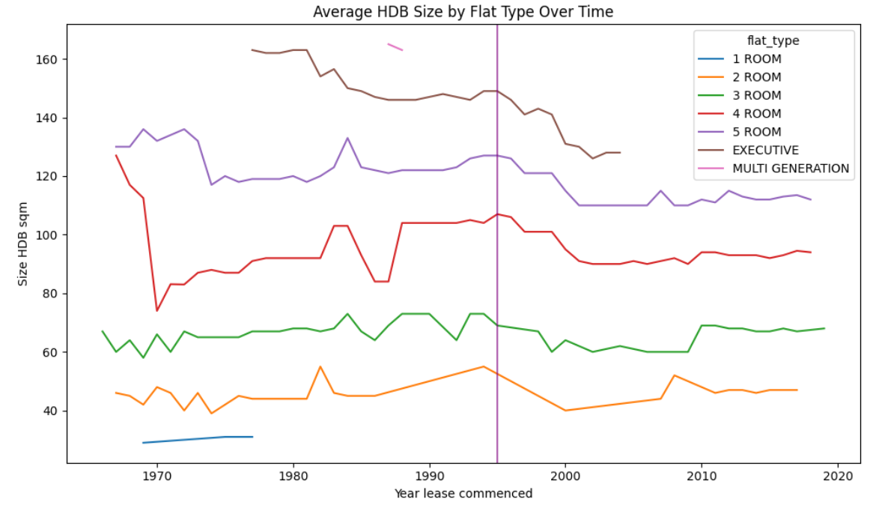
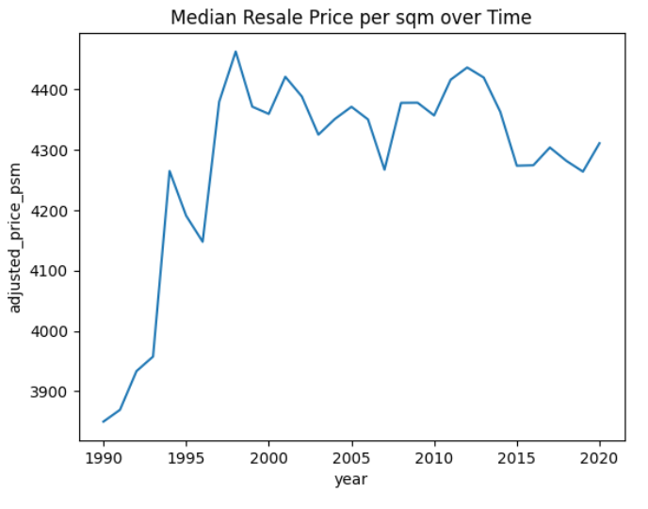
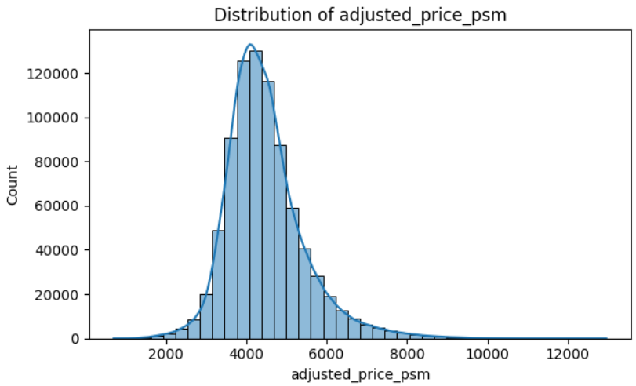
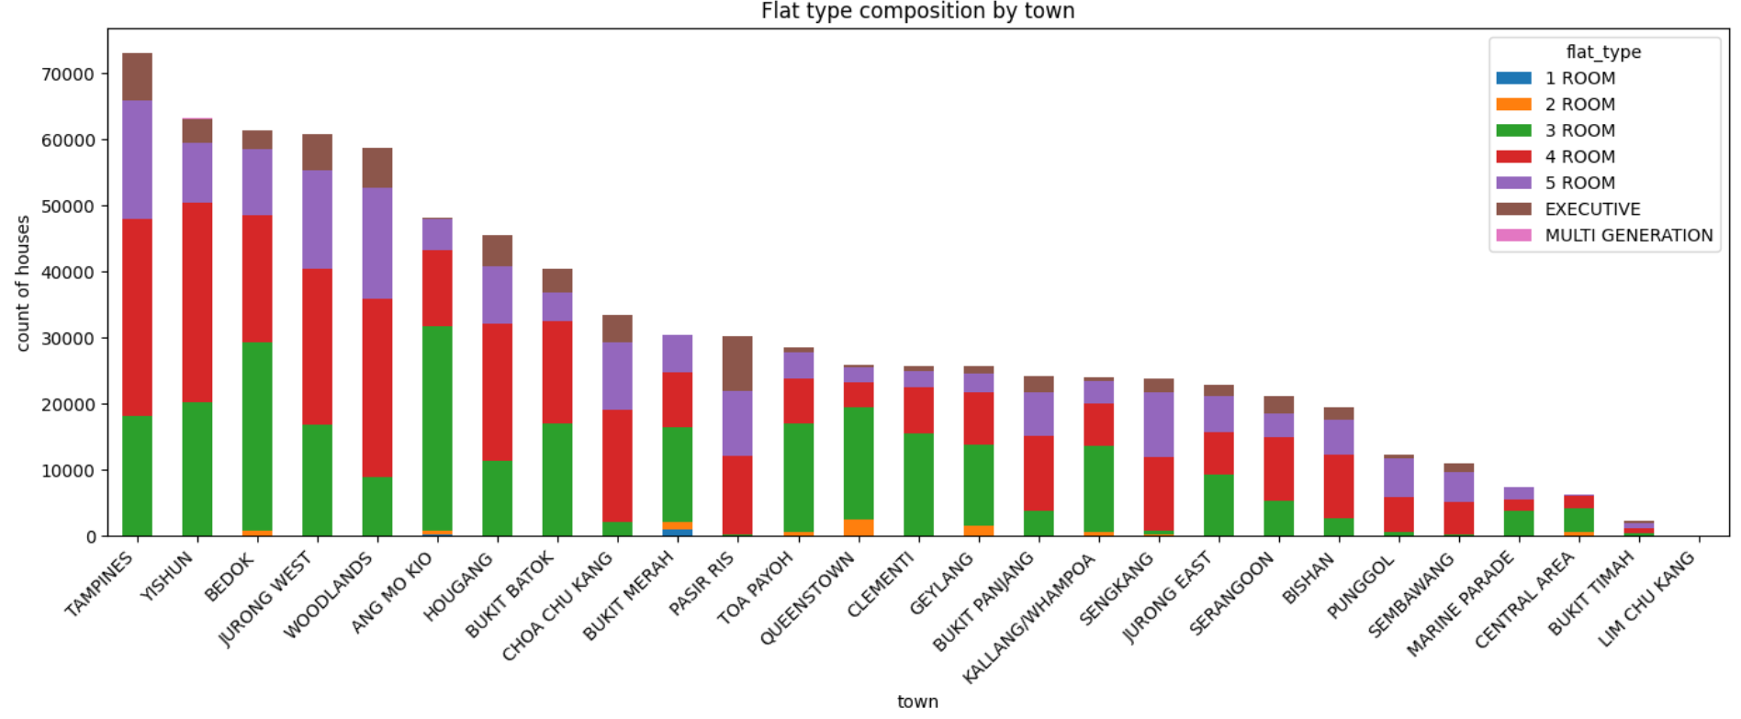
Exploratory Data Analysis I
Why Link Analysis?
Why Link Analysis?

Slide 4
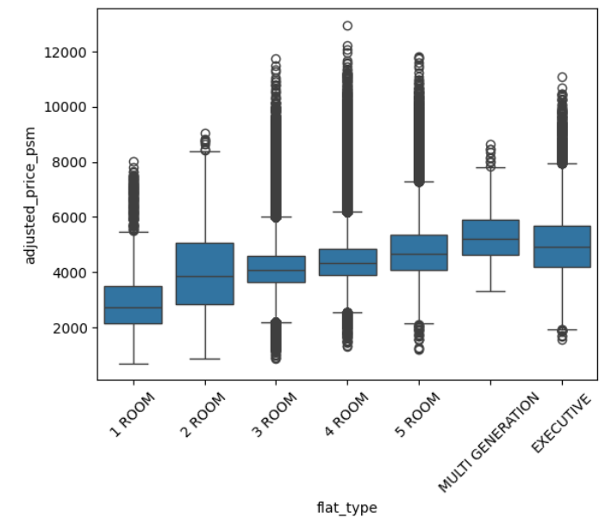
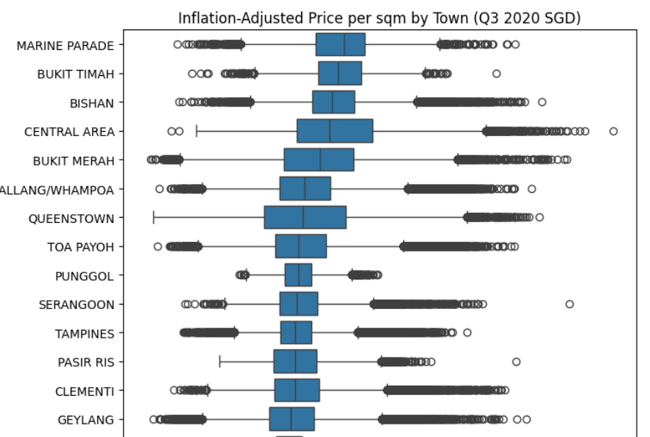
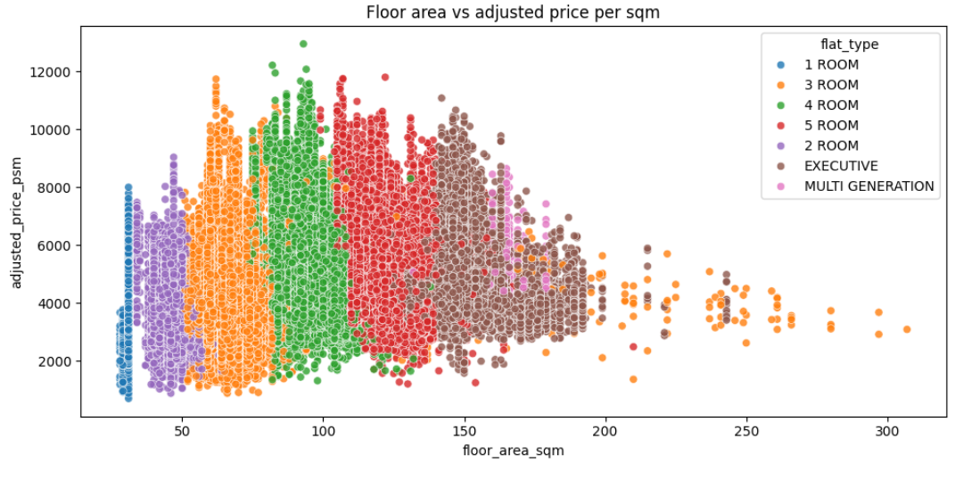
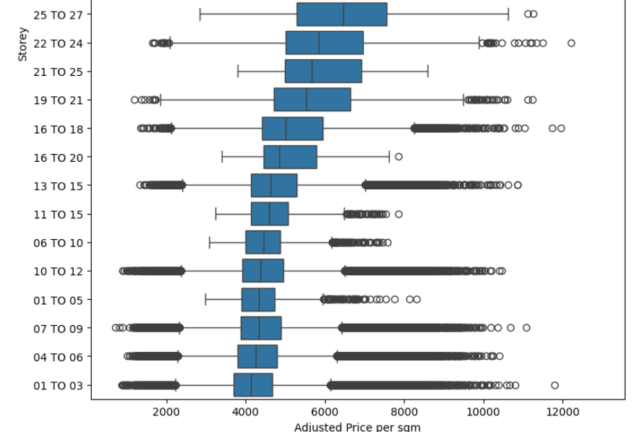
Exploratory Data Analysis II
Why Link Analysis?
Why Link Analysis?

Slide 5
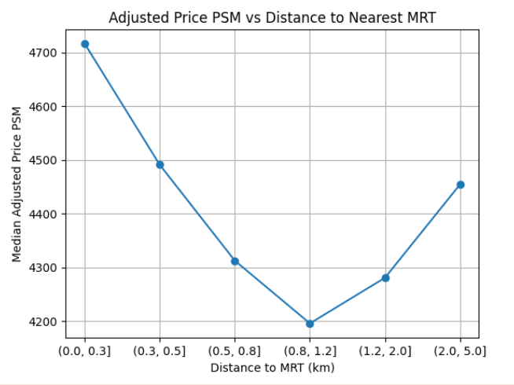
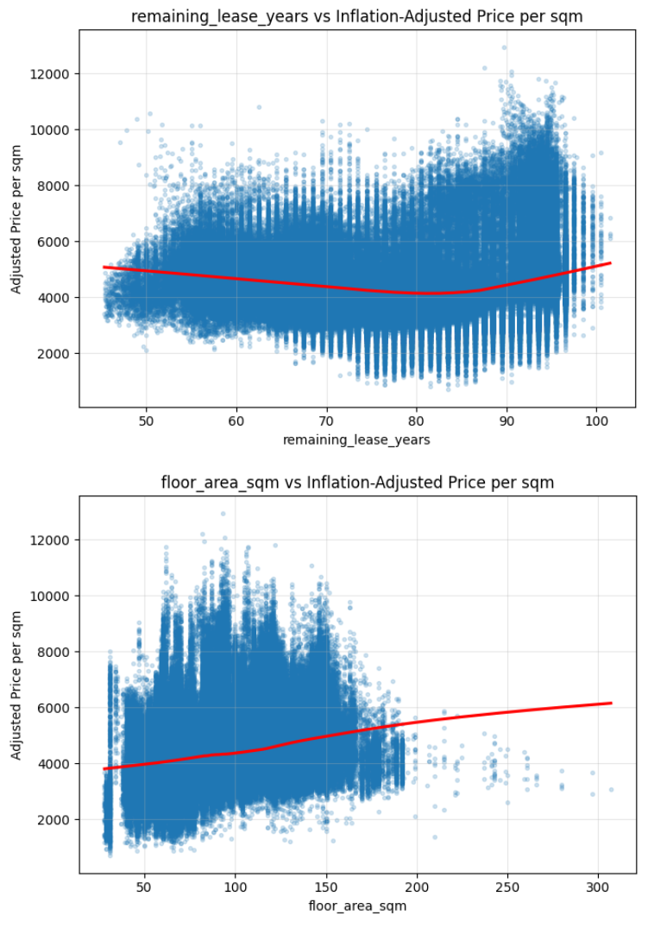
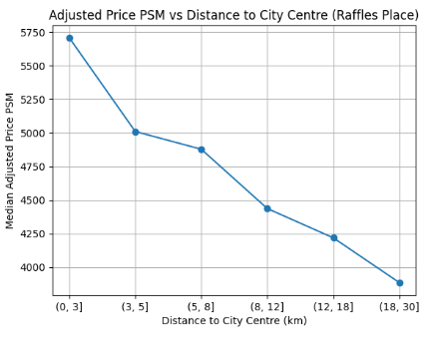
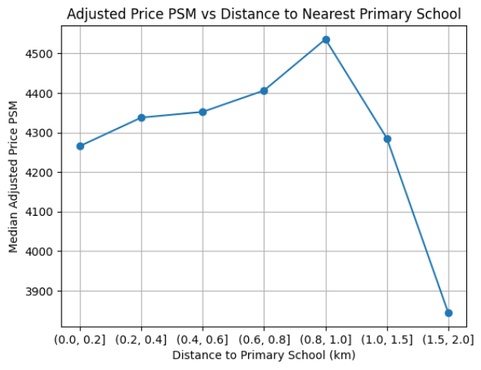
Exploratory Data Analysis III
Why Link Analysis?
Why Link Analysis?

Slide 6
Modeling Strategy
Modeling Strategy
Train–validation split based on time to avoid leakage
Train: listing year before 2015
Test: listing year 2015-2020
Baseline model: Ridge Regression
Advanced model: XGBoost Regressor
Evaluation metric: MAE, RMSE
Target: 'adjusted_price_psm'
Categorical: 'town', 'flat_type', 'flat_model'
Numerical: 'remaining_lease_years', 'floor_area_sqm','storey_mid', 'nearest_mrt_dist_km', 'nearest_primary_dist_km', 'dist_to_city_centre_km'
Final Features:
Model Pipeline
Base model Ridge:
One-Hot: Categorical Features
Numerical imputation: median
Categorica imputation: Mode
Standard scaler for num_cols
Tree model:
Xgb + TimeSeriesSplit + crossvalidation +RandomSearch
Why Link Analysis?
Why Link Analysis?

Slide 7
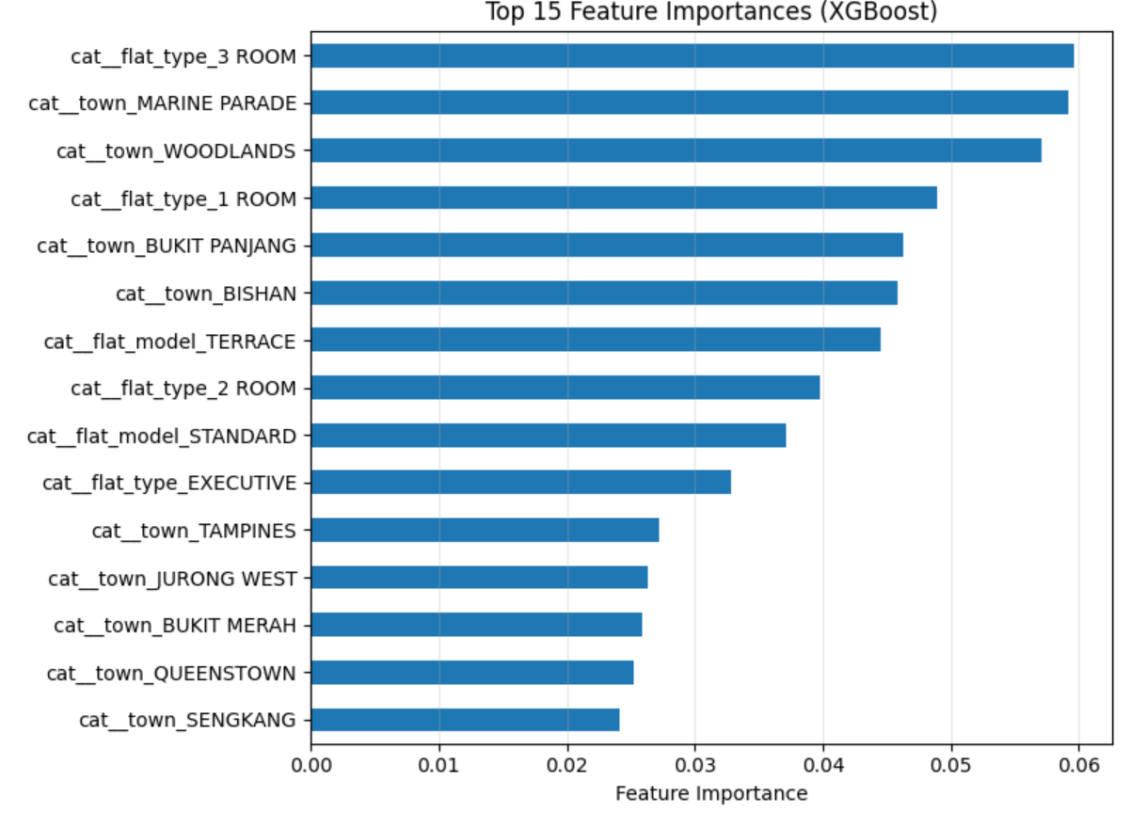

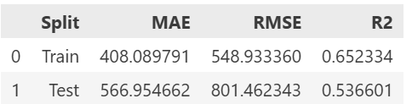
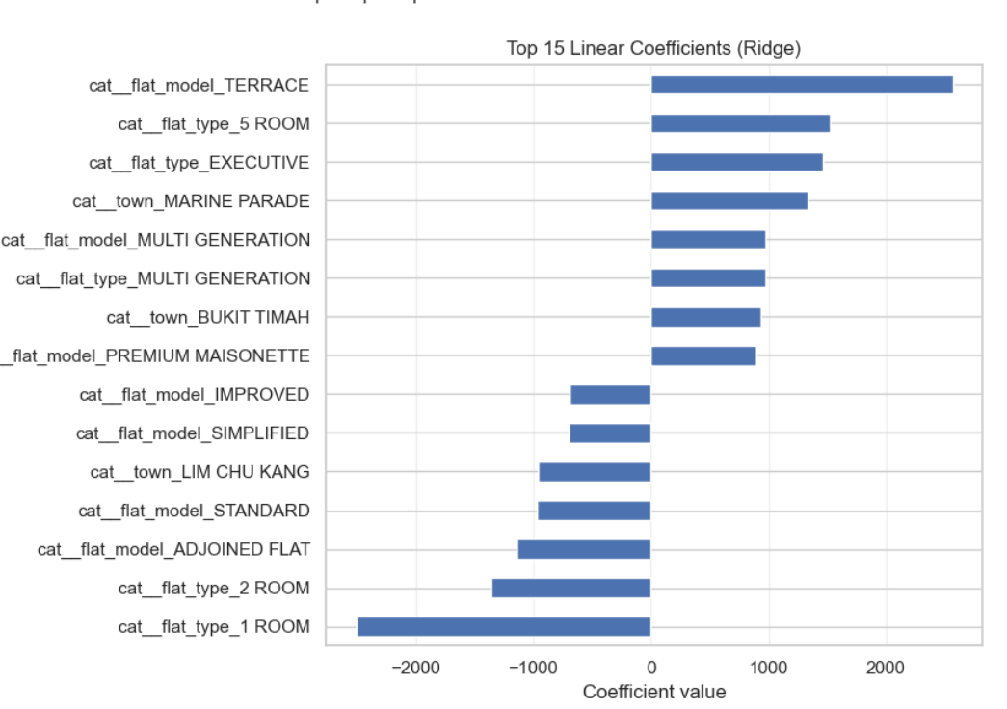
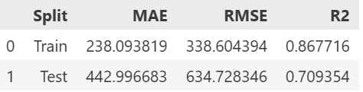
Result
Ridge
Without hyperparameter tuning
With hyperparameter tuning
Xgb
Why Link Analysis?
Why Link Analysis?

Slide 8
Link Analysis: Understanding Housing Market Structure
Why Link Analysis?
Graph Definition
Nodes: Individual HDB resale transactions (Jan 2017 onwards)
Edges: Connect comparable listings based on:
Same block with similar storey levels
Same street, same flat type, and close transaction years
Key Design Principle
Focus on comparability, not price
Graph complements (not replaces) tabular price prediction
based on:
Same block with similar storey levels
Same street, same flat type, and close transaction years
Why Link Analysis?
Why Link Analysis?
Traditional predictive models explain price levels, but not market structure
Buyers and valuers rely on comparable transactions
Link analysis models how listings are connected via similarity

Slide 9
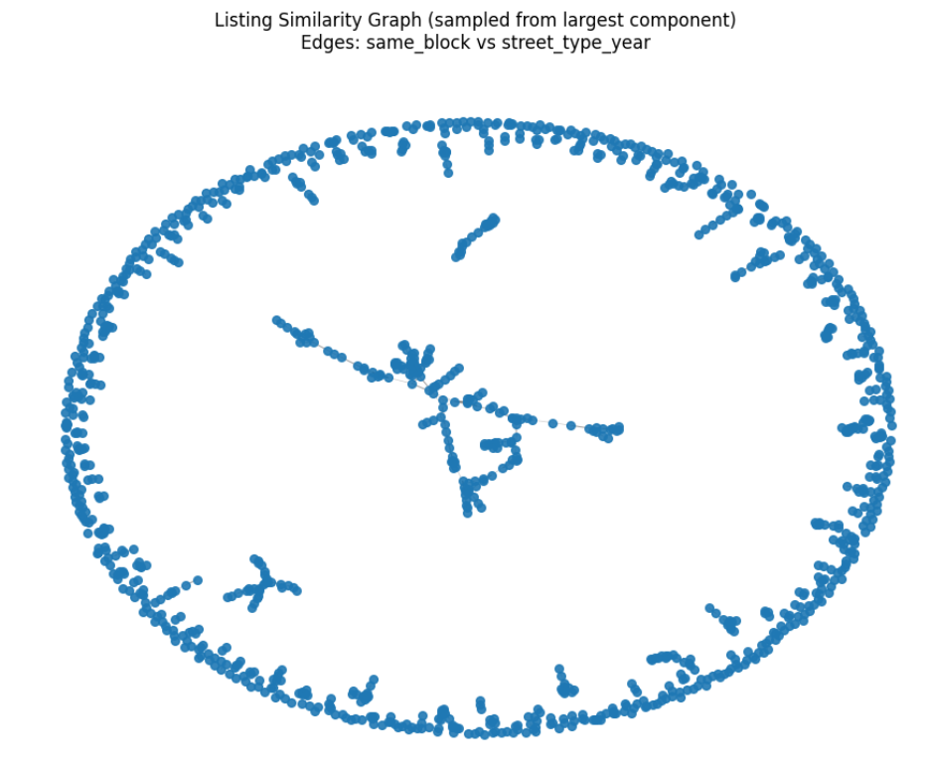
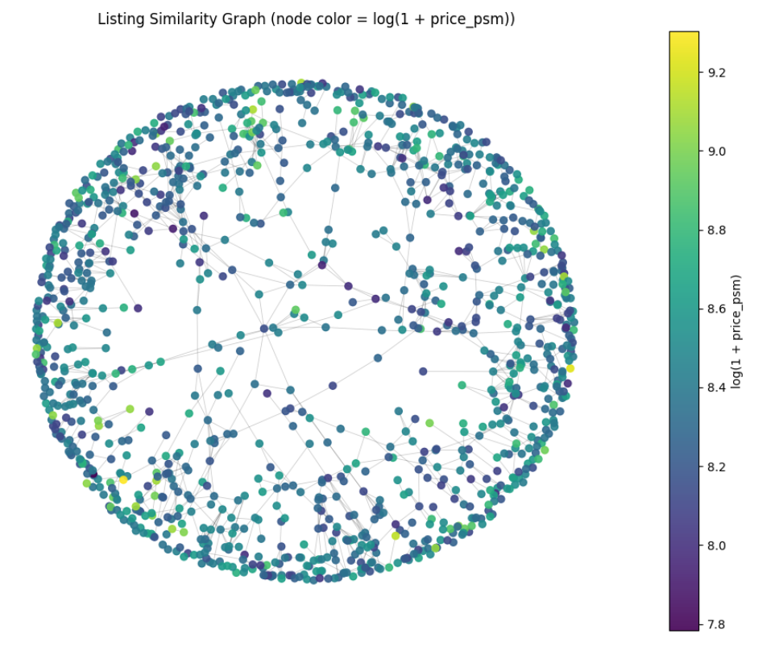
Graph Overview & Structural Properties
Graph Statistics
Nodes: 80374
Edges: 4797445
Average degree: 119.38
Density: 0.001485
43 connected components
Largest component contains 97.0% of listings
Interpretation
Majority of the resale market is highly interconnected
Most listings can be compared through chains of similar transactions
Small components represent niche or sparse segments
This indicates a mature and liquid housing resale market with strong comparability.
Why Link Analysis?
Why Link Analysis?

Slide 10
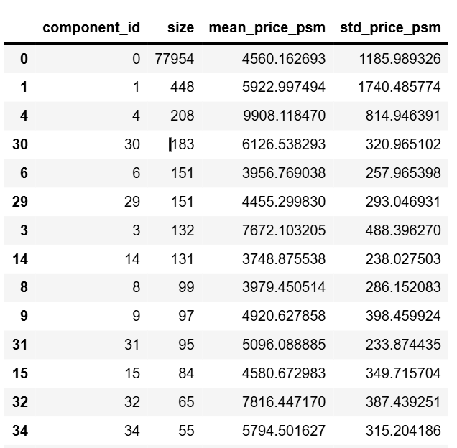
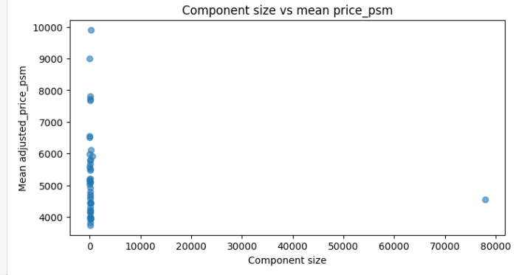
Micro-Markets via Connected Components
Method
Connected components treated as micro-markets
Each component groups listings that are mutually comparable
Observations
One dominant component captures mainstream housing segments
Smaller components often show: Higher average prices, Greater price volatility
Connected Components Reveal Micro-Markets Beyond Town
Several smaller components exhibit significantly higher mean prices and low price variance.
These components likely represent structurally homogeneous micro-markets that are weakly connected to the broader market.
Importantly, these clusters are not aligned with town boundaries, highlighting the limitation of purely location-based analysis.
Why Link Analysis?

Slide 11
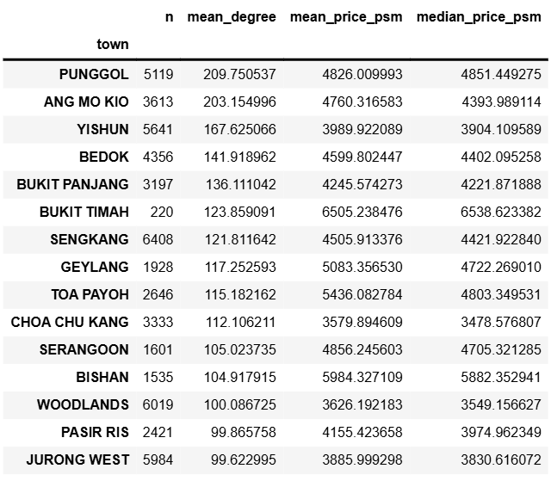
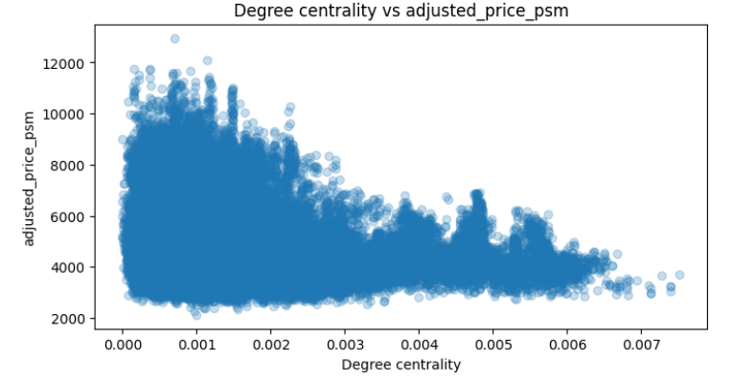
Degree Centrality: Reference Listings
What is Degree Centrality?
Measures how many similar listings a transaction is connected to
High degree → many comparables → strong reference value
Findings
High-centrality listings are typically:
  In towns with high transaction volume (e.g. Yishun, Ang Mo Kio)
  Standard flat types and layouts
These listings act as market benchmarks
High centrality Is not equal to high price. Centrality captures market representativeness, not price premium
Why Link Analysis?
Why Link Analysis?

Slide 12
Key Takeaways
Key Insights
Housing resale market is highly connected via comparable listings
Micro-markets exist even within the same town
Representative listings can be identified structurally
Alignment with Tabular Model
Graph similarity rules align with key predictive features:
  Town, flat type
  Storey level, floor area
  Distance-based features
Ensures analytical consistency
Practical Implications
Supports more robust valuation through comparables
Helps identify segments with limited comparability
Provides interpretable structure to complement ML predictions
Why Link Analysis?
Why Link Analysis?

Slide 13
Thank you!

